Slide 1
Software

Slide 2
Software
Software consists of instructions and code written by programmers in any of various special computer languages.
Software is divided commonly into two main categories:
(1) System software: controls the basic (and invisible to the user) functions of a computer and comes usually preinstalled with the machine. See also BIOS and Operating System.
(2) Application software: handles multitudes of common and specialized tasks a user wants to perform, such as accounting, communicating, data processing, word processing.

Slide 3
Operating system
The operating system is the most important program that runs on a computer. Every general-purpose computer must have an operating system to run other programs.
Operating systems perform basic tasks, such as recognizing input from the keyboard, sending output to the display screen, keeping track of files and directories on the disk, and controlling peripheral devices such as disk drives and printers.
For large systems, the operating system has even greater responsibilities and powers. It is like a traffic cop -- it makes sure that different programs and users running at the same time do not interfere with each other. The operating system is also responsible for security, ensuring that unauthorized users do not access the system.

Slide 4
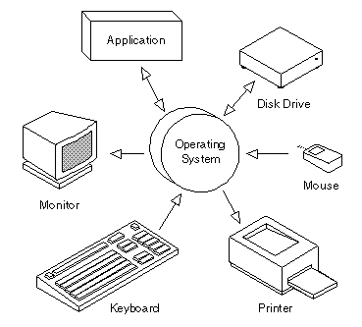

Slide 5
Operating systems can be classified as follows:
Multi-user: Allows two or more users to run programs at the same time. Some operating systems permit hundreds or even thousands of concurrent users.
Multiprocessing: Supports running a program on more than one CPU.
Multitasking : Allows more than one program to run concurrently.
Real time: Responds to input instantly. General-purpose operating systems, such as DOS and UNIX, are not real-time.

Slide 6
Utility programs
A program that performs a very specific task, usually related to managing system resources. Operating systems contain a number of utilities for managing disk drives, printers, and other devices.
Utilities differ from applications mostly in terms of size, complexity and function.
For example, word processors, spreadsheet programs, and database applications are considered applications because they are large programs that perform a variety of functions not directly related to managing computer resources.

Slide 7
Library programs
In computer science, a library is a collection of implementations of behavior, written in terms of a language, that has a well-defined interface by which the behavior is invoked.
In addition, the behavior is provided for reuse by multiple independent programs. A program invokes the library-provided behavior via a mechanism of the language.
For example, in a simple imperative language such as C, the behavior in a library is invoked by using C's normal function-call. What distinguishes the call as being to a library, versus being to another function in the same program, is the way that the code is organized in the system.

Slide 8
General purpose software
General purpose application software
General purpose application software is a type of software that can be used for a variety of tasks. It is not limited to one particular function. For example a word processor could be classed as general purpose software as it would allow a user to write a novel, create a restaurant menu or even make a poster.
Examples of General purpose application software include: Word processors, Spreadsheet and Presentation software. Whatever you do, do not use brand names!

Slide 9
Special purpose software
Special purpose application software
Special purpose application software is a type of software created to execute one specific task. For example a camera application on your phone will only allow you to take and share pictures. Another example would be a chess game, it would only allow you to play chess.
Other examples of special purpose application software are web browsers, calculators, media players, calendar programs etc. Again, make sure that you don't use brand names!

